Slide 1
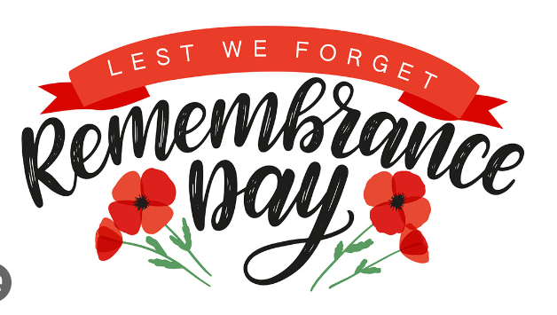
Remembrance Day!

Slide 2
Quote
Remember, Lord, those whose minds were darkened and disturbed by memories of war. All Jesus, remember them when you come into your kingdom. Remember, Lord, those who suffered in silence, and those whose bodies were disfigured by injury and pain. All Jesus, remember them when you come into your kingdom.

Slide 3
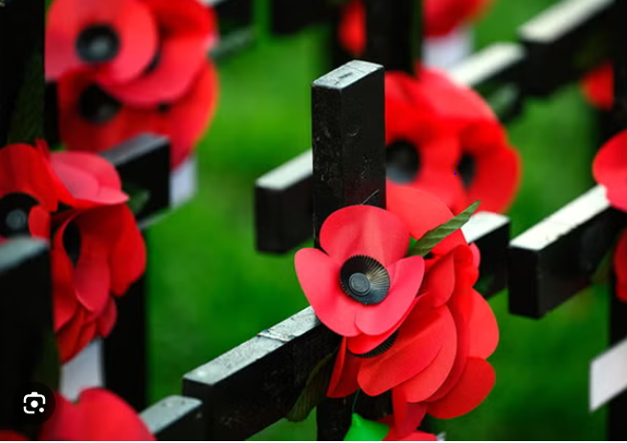
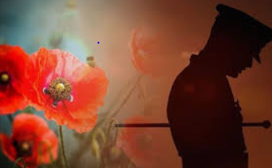
What do you think remembrance day is about?

Slide 4
A.A day to give donations to the poor. B.Where you plant poppies and watch them grow.
C.To remember the soldiers who died in the war.
D.A celebration were you spend time with your family.

Slide 5
C.To remember the soldiers who died in the war.

Slide 6
Do you know how many wars are happening today?

Slide 7
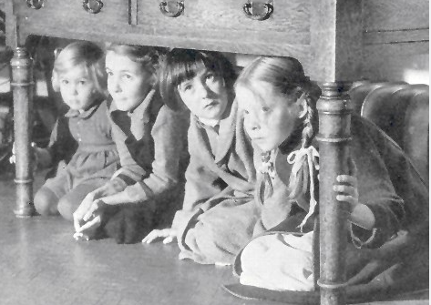
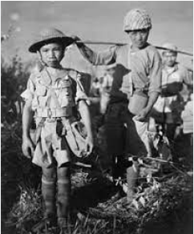
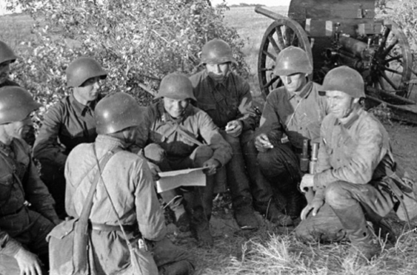
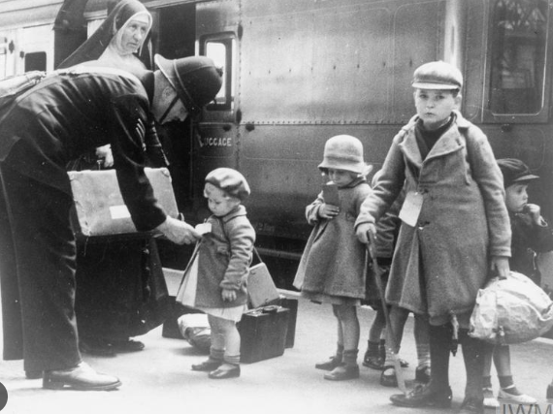
32

Slide 8
Current wars
Right now, there is war in Gaza .people are dying and no-one is safe . People need food water and fuel's so we need to remember people who died in the war.

Slide 9
Why do you think poppies are important in the war?
Wearing a poppy is a show of support for the service and sacrifice of our Armed Forces, veterans and their families. It represents all those who lost their lives on active service, from the beginning of the First World War right up to present day.

Slide 10
Different types of poppies
HOW MANY DO YOU THINK THERE ARE ?

Slide 11
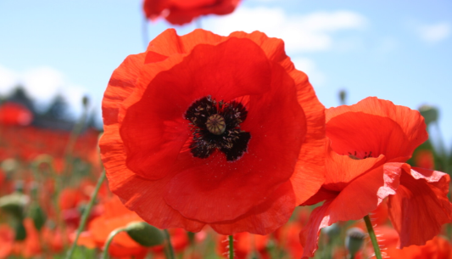
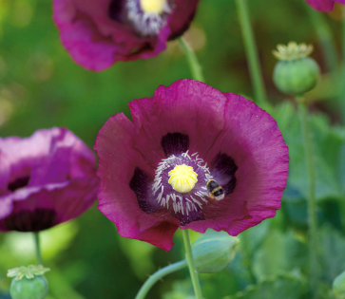
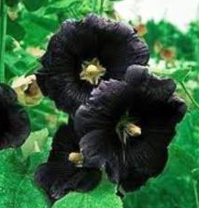
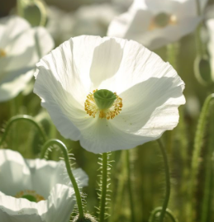
Red poppy : Remembrance and hope
Purple poppy: Animals that become a victim of war
Black poppy: The contribution of Black African and Caribbean commutes communities to the war effort a service man/woman
White poppy: remembrance people who died in conflict with focus on the end of the war

Slide 12
PRAYER

