Slide 1
Values
By the Ethos team

Slide 2
Today we are looking at our values and what they mean to us .
What is your favourite value ?
What do they mean to you ?

Slide 3
Love

Slide 4
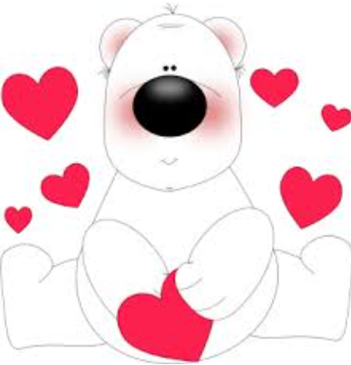
Love is our main value
All of our values link to love which is why it is our main value . We use love every day .

Slide 5
Sometimes showing love is hard .
If someone is mean to you it might be hard to show love because you want to retaliate but you should forgive and show love . Retaliating is doing what they did to you back . Is someone pushed you and you push them back that is retaliating.

Slide 6
The story of love
The story we choose that links to love is Jesus and the children . Some children came to Jesus but the disciples told them to go away because Jesus was busy . Jesus loved children and he wasn’t that busy so he told the children to “come to me”. The full quote was 'Let the little children come to me, and do not hinder them, for the kingdom of heaven belongs to such as these. '

Slide 7
Faith

Slide 8
Without faith it is impossible to please God, because anyone who comes to him must believe that he exists and that he rewards those who earnestly seek him. Hebrews 11 : 6

Slide 9
This Bible verse is telling us that it’s impossible to please God if you don’t have any faith in him. It’s also saying that if we have faith in God we will be rewarded.

Slide 10
Now faith is confidence in what we hope for and assurance about what we do not see. This is saying that faith is confidence about what we don’t see. Hebrews 11:1

Slide 11
Respect

Slide 12
Matthew 7:12
“Do to others whatever you would like them to do to you. This is the essence of all that is taught in the law and the prophets.”

Slide 13
The Golden Rule instructs us to treat others with the same respect, kindness, and fairness that we desire for ourselves. Respecting others involves considering their feelings, needs, and well-being in our interactions. We should treat others with the respect that we would want them to show to us.

Slide 14
If you want lots of respect then you have to give it. Love your neighbour as yourself and do to others as you would like them to do to you . Jesus showed lots of respect and got it back by his disciples and a lot of people . We don’t always get respect back but we shouldn’t retaliate and not show respect back . We should show all of our Christian values ( that’s what they are there for )

Slide 16
1 Thessalonians 5:18
“Give thanks in all circumstances; for this is the will of God in Christ Jesus for you”

Slide 17
Let us come into his presence with thanksgiving; let us make a joyful noise to him with songs of praise!" (Psalm 95:2).

Slide 18
This means that God wants you to be thankful for all he has done for us . Even if something is happening in your life it is apart of God’s plan so we should try to be thankful . Sometimes it can be really hard but we can ask for his help .

Slide 19
Forgiveness

Slide 20
Matthew 6: 14-15
“For if you forgive other people when they sin against you, your heavenly Father will also forgive you. But if you do not forgive others their sins, your Father will not forgive your sins.”

Slide 21
This basically means that if you do not like somebody because of something they did and you don’t forgive them then God will not forgive you . You have to forgive people because we are not perfect either so its not right to not forgive .

Slide 22
All of our Christian values are hard especially forgiveness but we should still try our best and be kind to everyone .
Try and think of a time when you didn’t forgive someone and think , were you happy then ? Are you still holding a grudge now ? How can you improve and try to forgive .

Slide 23
Compassion

Slide 25
This means that he shows justice and when he gets only gets angry when we sin which is fair . He is so rich in love because he is a loving God .

Slide 26
Compassion is just like empathy , showing compassion is like showing love . God is slow to anger because he is empathetic too .

Slide 28
Isaiah 40:31 but those who hope in the lord will renew their strength
Micah 7:7 but as for me, I watch in hope for the lord, I wait for my god my saviour; my god will hear me

Slide 29
The Isaiah one means that if we have hope in Jesus our strength will be renewed both in the mind and body
The last one means that if you watch and hope in the lord he will hear your answers and prayers

Slide 30
You will be strong if you believe in him because the thought of him makes you feel strong and loved . God always listens to our prayers but he dose not always say yes .

Slide 31
Thank you for giving us our values and our school and all of the staff . Thank you for loving us all even when we don’t show love back . Please keep us all save . We pray that the people doing their SATs will try their best and that that will pay of
Amen

